Slide 1
Security Safety
2018

Slide 2
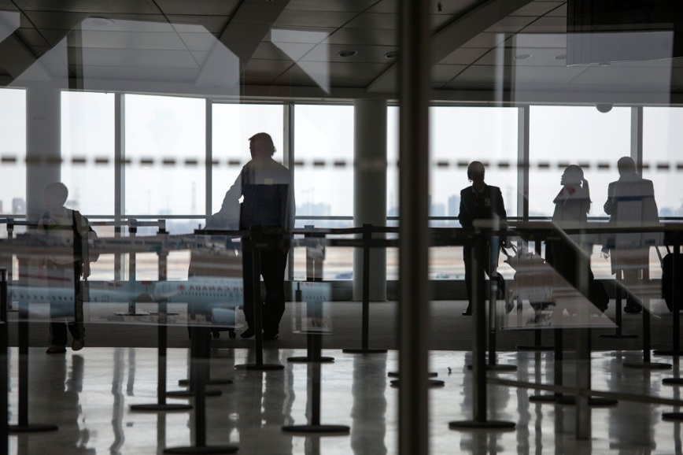
Security Safety
You are an important member of the airport team. Although everyone's job descriptions are different, everyone - including you - is equally responsible for ensuring the security and safety of our airport and passengers.
Some of the ways you can do this are by:
Preventing Piggybacking
Monitoring Suspicious Persons, Vehicles and Activities
Ensuring care and control of prohibited items
Challenging for Identification

Slide 3
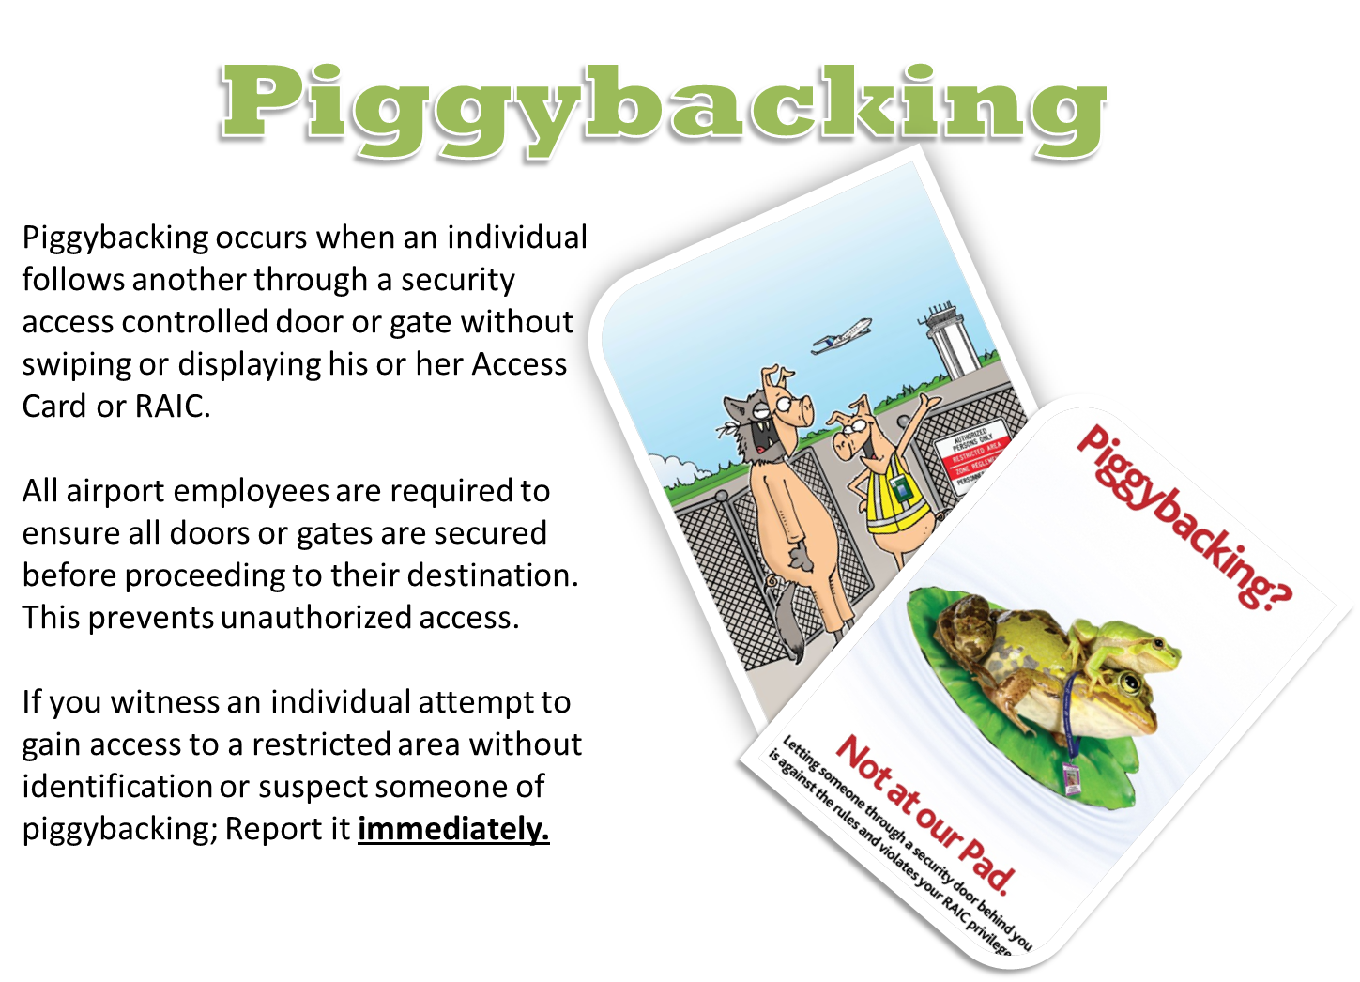

Slide 4
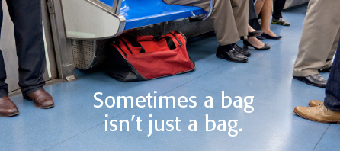
SUSPICIOUS PERSONS, VEHICLES & ACTIVITIES
Some examples of Suspicious Activities:
Individuals within the Airside Restricted Area without proper ID
People, Vehicles or Objects that look out of place which cannot be easily explained.
People intentionally trying to attract attention to themselves.
Individuals taking pictures / videos of restricted areas.
If you witness a security incident, breach of security or activity that seems out of place, report it immediately.

Slide 5

Prohibited Items
Security’s main job is to prevent unauthorized persons and items from entering the restricted area. As employees we are given certain privileges that is not given to a passenger. In order to complete our work we must have access to Prohibited Items (anything that would be taken away from a passenger when they are travelling through Pre-Board Screening). When in the Restricted Area we must maintain full care and control of all Prohibited Items, this means not turning our backs on tools, not leaving our tools in unsecure hording or tool boxes, and of course not handing a screw driver to a passenger.
Any violation could result in a $5000 personal fine (per tool)
For any further information please contact the
YYC Security Department at Security@yyc.com

Slide 6
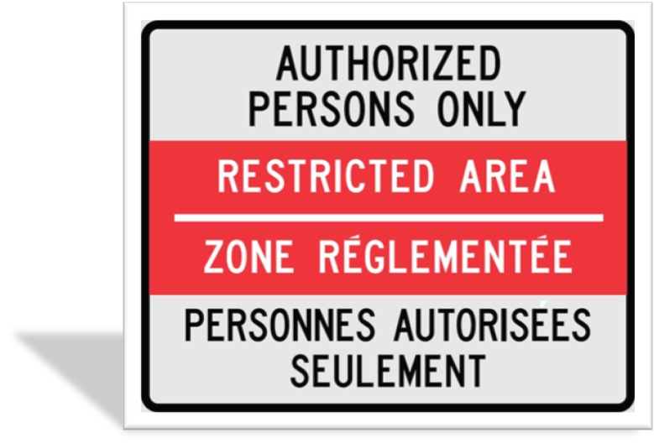
ASK FOR ID
Restricted Area Access:
Identification must be physically displayed at all times while in a Restricted Area.
The only valid reason for employees to enter the Restricted Area is for work related purposes.
If you suspect that someone within the Restricted Area should not be there, challenge them to display their identification and ask why they are in the area.
Know the expiry date of your Airport Pass and don’t forget to renew it on time.

Slide 7
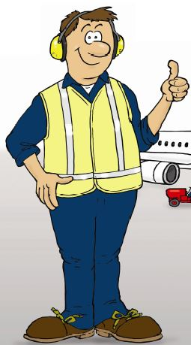
Security Review
Being aware of security initiatives including
Piggybacking
Suspicious Persons, Vehicles and Activities
Care and control of prohibited items
Asking for Identification promotes the overall safety and security at the airport.
Whether you work with passengers, cargo, operations or security; you have a role in keeping the industry safe.
Remember, security is everybody's business!
See something? Say something!

Slide 8
REMINDER: Security Reporting Methods
Airport Emergencies:
911 and then 403-735-(1300)
Airport Non-Emergencies:
YYC’s Integrated Operations Centre (IOC)
403-735-(1300)

